Slide 1

INTRODUCTION, HISTORY, INSTRUCTION SET, SECURITY AND LIVE DEMONSTRATION
R Midhun Suresh | S7CS2 | Roll 47
Guided by Mr. Shibu V S

Slide 2
ROADMAP
Introduction
History
Working
Instruction Set
Security
What and Why
WASM vs the past
Internal Mechanism
Raw Code
Sandboxing
Live Demo
Compiling some C++ 17 code to WASM and integrating it with JavaScript
A 15 minute speedrun of WebAssembly

Slide 3





WebAssembly
Introduction
What
Why
Is WASM?
Is it important?
Binary Format
Runs on a stack machine
Run C/C++ Code on the web
Compilation Target
JavaScript is not fast enough
Native level performance on the web
Software and hardware independent
Compact
WebAssembly 1.0 is available on

Slide 4









History of running Native code on the web
ActiveX
Java Applets
NaCl/ PNaCl
asm.js
Relied on code signing
Not Portable
Security Issues
Required JRE
Replaced by JavaScript
Independent from JS & Web API
Only Supported on Chrome
Subset of JavaScript
Complex to extend

Slide 5



Working
How are languages compiled to WASM?
How does WASM execute on the browser?
Memory model
Components of a WASM program

Slide 6

C/C++ Code
COMPILER FRONT-END
Compiling to WASM binary
LLVM Intermediate Representation
Uses LLVM Backend
COMPILER BACK-END
LLVM
WASM binary
Emscripten

Slide 7

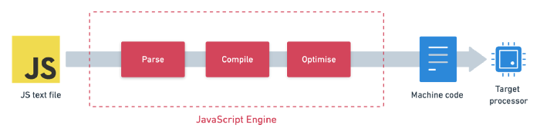
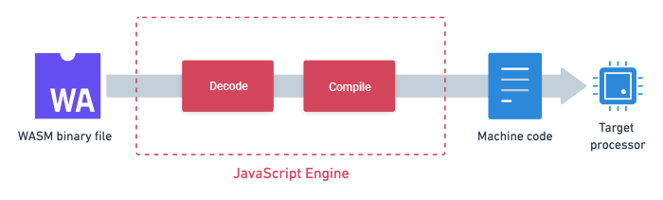
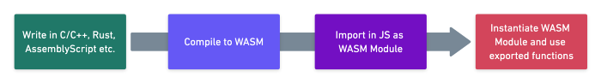
Running WASM on the browser
JavaScript Pipeline
WASM Pipeline
How it all fits together

Slide 8

WASM Memory Model
WebAssembly uses an array for memory
Byte1 | Byte2 | Byte3 | Byte4 | Byte5 | Byte6 | Byte7 | …
ArrayBuffer
Object
Linear Array of bytes
Benefits:
Memory Safety
No leaks
Instructions:
grow_memory
Used to expand the array of bytes subject to available total memory
Memory increases in units of 64KB
current_memory
Gives currently allocated memory
Load & Store
Used for memory access

Slide 9




Components
of a WASM binary
Basic unit of WASM program
Modules
Data Types
Contains definitions for functions, local and global variables
Can be exported and imported
4 datatypes
32 bit Integer
64 bit Integer
32 bit float
64 bit float
Takes in WASM values and returns WASM values
Functions
Instructions
Not first class citizen
Recurse, Call other functions but cannot nest functions
Based on stack machine
Implicit Operands
Makes binary smaller
Easier to implement

Slide 10
Common Instructions in WASM
Numeric Instructions
add, sub, mul, div_sx, rem_sx
abs, neg, sqrt, ceil, floor
eq, ne, lt, gt, le, ge
inn.const, fnn.const

Slide 11
Common Instructions in WASM
Variable Instructions
local.get, local.set
global.get, global.set
local.tee

Slide 12
Common Instructions in WASM
Memory Instructions
inn.load, inn.store
fnn.load, fnn.store
memory.size, memory.grow

Slide 13
Common Instructions in WASM
Control Instructions
nop, unreachable
block, loop, if, else, end
br, br_if, br_table
call, call_indirect

Slide 14
SECURITY
Bound Checks
Isolated Memory
Garbage Collected
Control-Flow Integrity
Labels based on nesting
Memory
Validation
Sandbox
Runs in additional Sandbox
Restricted by rules
Eg: Same Origin Policy

Slide 15

Pseudo Code
const int n=50
array a = [0]
for int i in 1..n
let a[i] = 1
int m = int(sqrt(n))
for int i in 2..m
if a[i]
for int j in 2.. n step 2
a[i * j] = false
/for
/if
/for
DEMO
Implementing Sieve of Eratosthenes in C++
C++ 17
Emscripten
ES6 Javascript

Slide 16


Thank You
Find the demo at
Find out more at
github.com/MidhunSureshR
https://webassembly.org
https://webassembly.github.io/spec/core/
https://developer.mozilla.org/en-US/docs/WebAssembly

